Slide 1
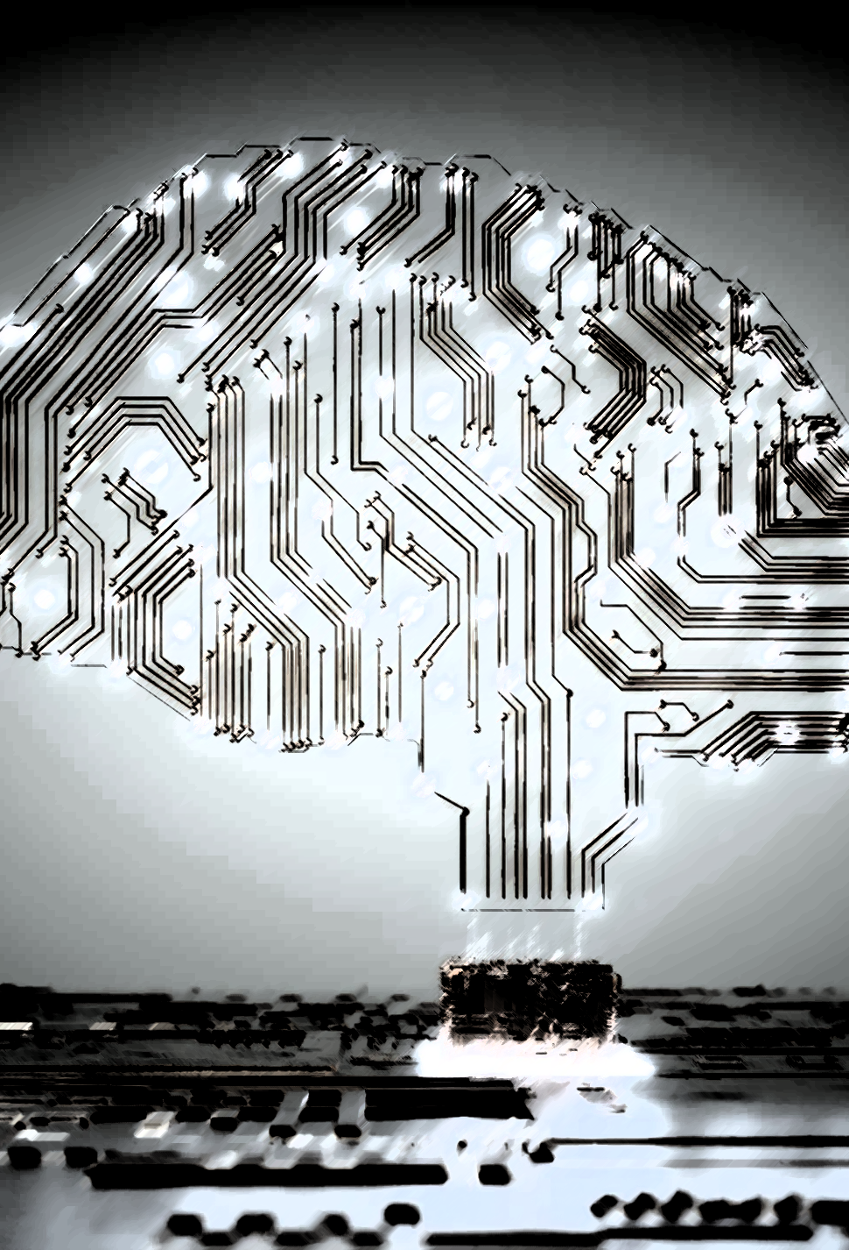
Technology and Artificial Intelligence
Influences on the way we work

Slide 2

Do Now
If you had worked in a job that relied on your skills and knowledge, how would you feel about new technologies that would make it easy to replace you?
Why?

Slide 3
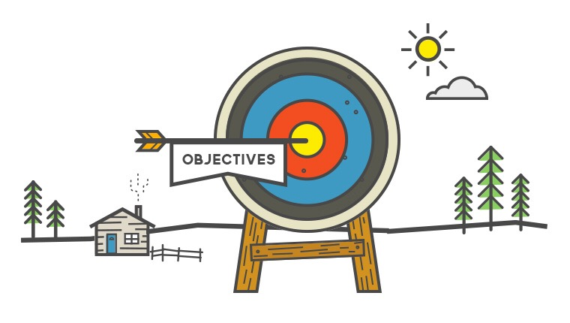
Success Criteria
Learning Intention
Explain how technology has changed one specific job industry.
Describe what jobs in the future may look like and what inputs robots might have on this.
To investigate the way that technology is changing the world of work.

Slide 4

Brainstorm
What industries and job roles have changed in recent years due to technology advances?

Slide 5


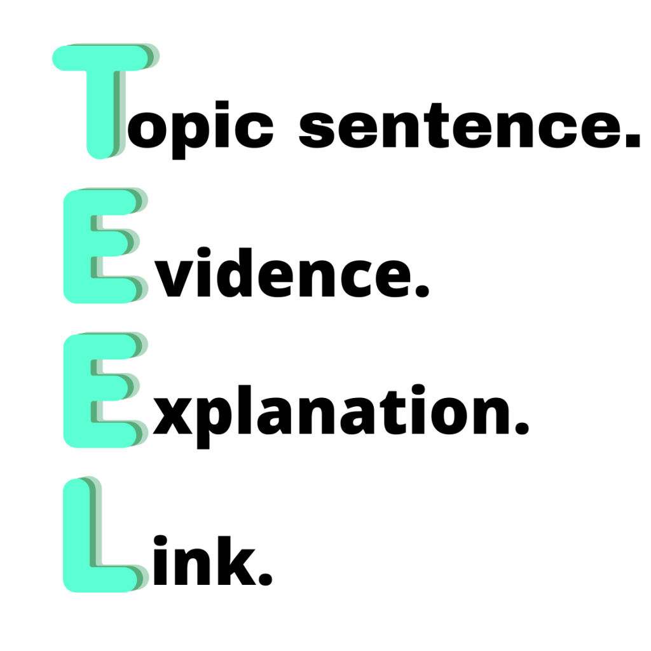

Write a Paragraph
Write a paragraph about one industry/job role we have brainstormed. In your paragraph, explain: - The job role - How was it performed then? - How is it performed now? - How does this affect people employed in this role/industry?

Slide 6


Future Jobs
https://www.abc.net.au/btn/classroom/future-jobs/10525832

Slide 7

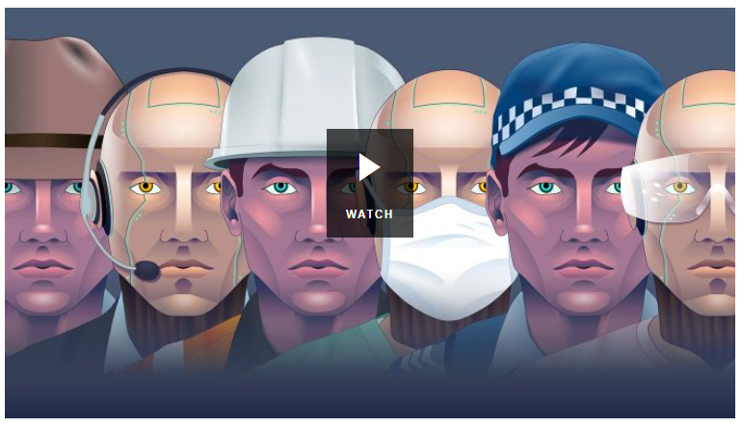
Robot Jobs
https://www.abc.net.au/btn/classroom/robot-jobs/10522582

